Slide 1

MP PROJECT END-SEM REPORT
Vth SEM E&C
BLUETOOTH CONTROLLED ROBOT USING 8051 MICROPROCESSOR
DEPARTMENT OF ELECTRONICS AND COMMUNICATION ENGINEERING
MANIPAL INSTITUTE OF TECHNOLOGY
(A Constituent Institution of Manipal Academy of Higher Education)
MANIPAL – 576104, KARNATAKA, INDIA
SEPTEMBER 2022

Slide 2
SUBMITTED BY:
STUDENT NAME: | REGISTRATION NUMBER: | SECTION-ROLL NUMBER:
VIRUPAAKSH VIVEK LAKHOTIA | 190907234 | 1
JASON PEREIRA | 200907008 | 2
ARK VERMA | 200907126 | 20
MANAS CHOUDHARY | 200907154 | 22

Slide 3
OBJECTIVE :
Robots are generally defined as an electro-mechanical machine, which we can guide through electric signals and computer programming. Nowadays, they have taken the world by storm, with multiple robots being built for innumerable tasks.
Our objective is to build a 2-wheel robot (with a caster wheel in the front) which can take data from our Bluetooth device and take decision based on the command received.
For example:- If the user gives ‘F’ command through his device, the robot should move forward. Similarly, on receiving ‘B’ it should move back from its current position.
Another secondary objective of the project is accumulation of data with the help of an ultrasonic sensor. The sensor will tell the distance of obstacles in front of the bot, which will allow the user in the process of decision making.

Slide 4
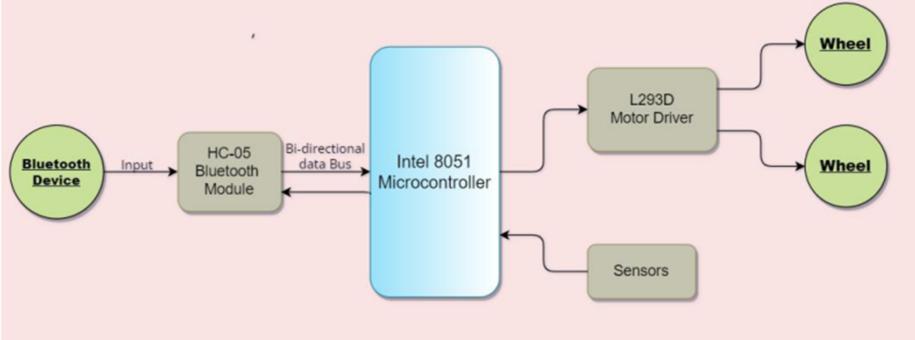
BLOCK DIAGRAM :
Block Diagram of Bluetooth controlled robot

Slide 5

SOFTWARE DETAILS

Slide 6
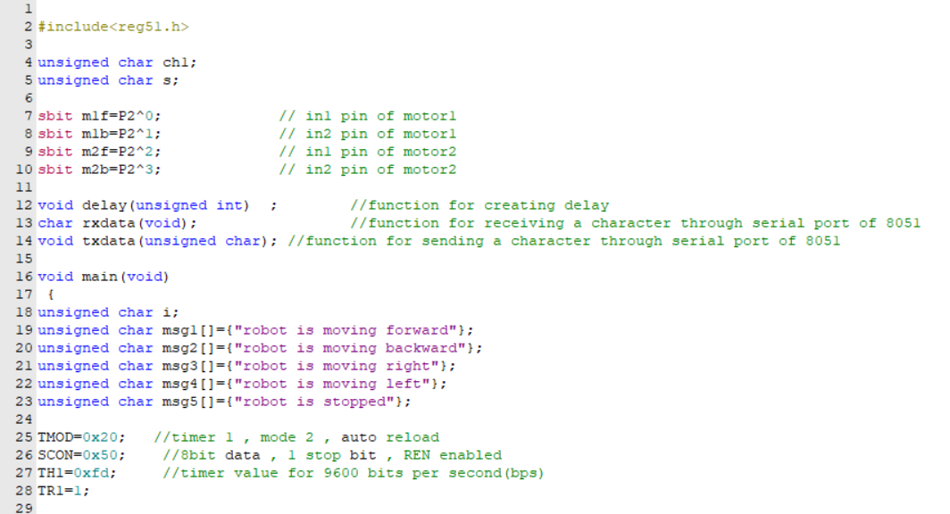
CODE:

Slide 7
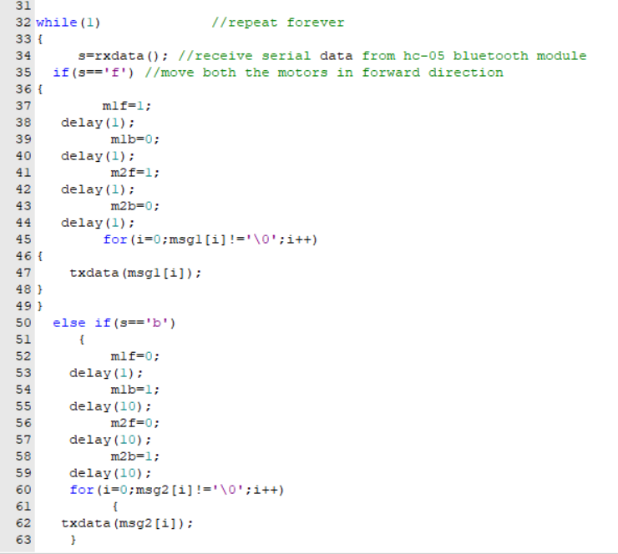
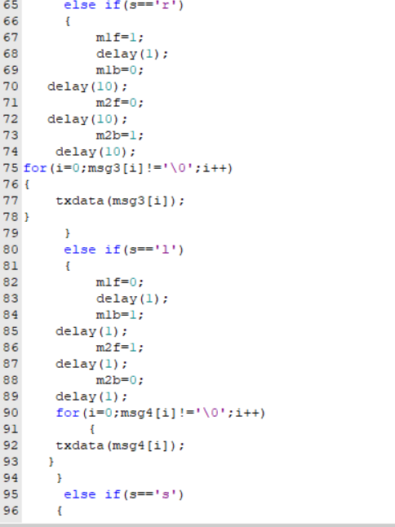
Code

Slide 8
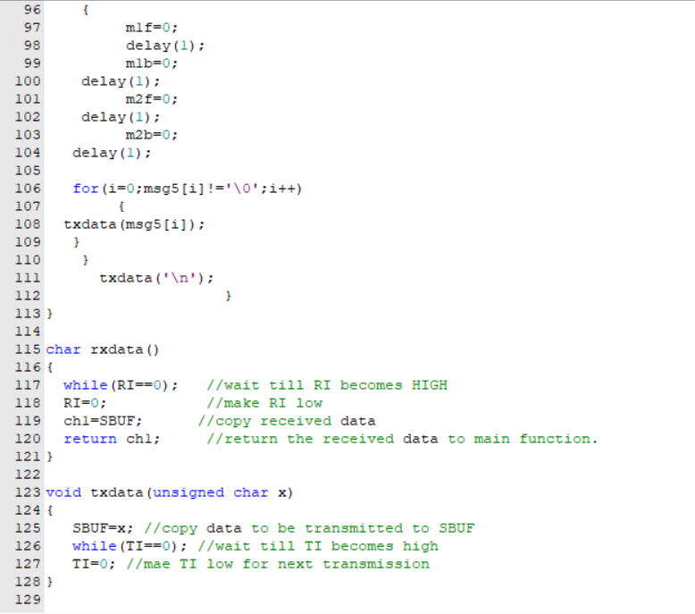

Slide 9
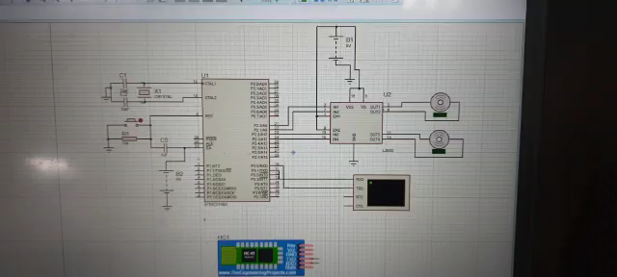
PARTIAL RESULTS (SOFTWARE SIMULATIONS):

Slide 10
Add Ultrasonic Sensor
Integrating the Code with the Robot.
Testing of Hardware and Software.
Simulation of Final Project.
FUTURE PLAN OF ACTION:

Slide 11
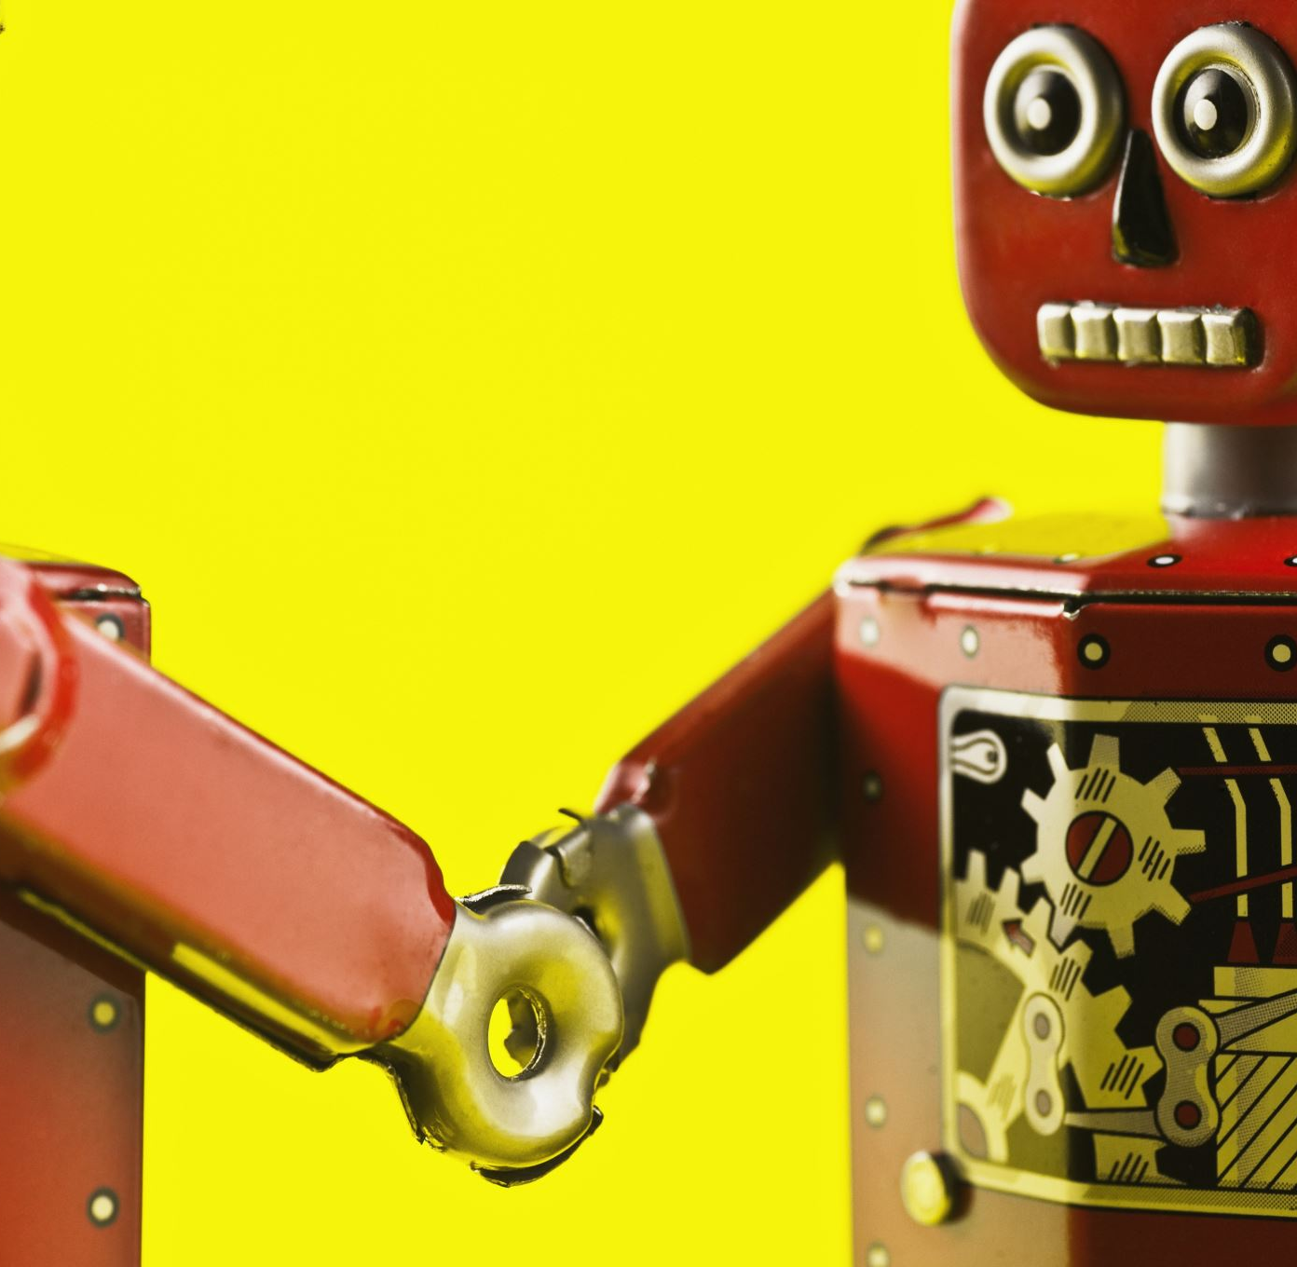
EXPECTED OUTCOME :
The expected outcome of the project is a Bluetooth controlled 2-wheel robot which can accumulate data through the sensors, distinguish between the different commands provided and move accordingly as desired by the user.

Slide 12

REFERENCES :
https://circuitdigest.com/microcontroller-projects
https://online.visual-paradigm.com/app/diagrams
https://robotics.stackexchange.com/
https://www2.keil.com/mdk5/learn
https://components101.com/wireless/hc-05-bluetooth-module

